Slide 1



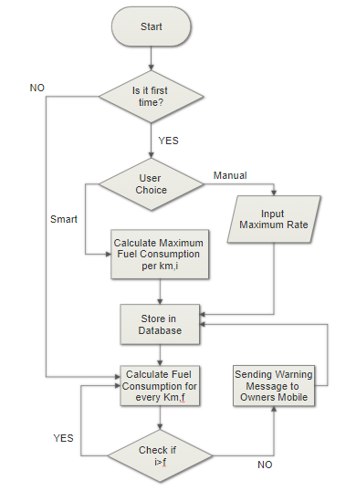
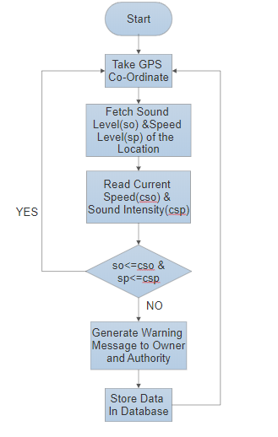
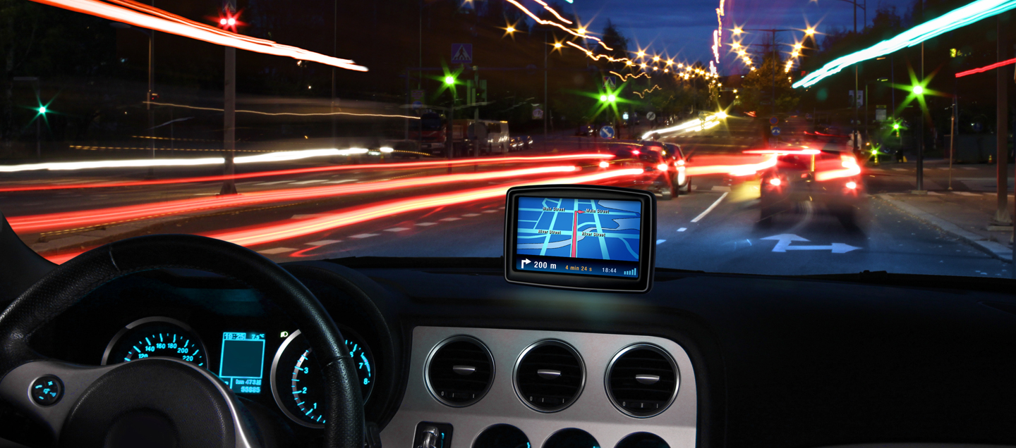
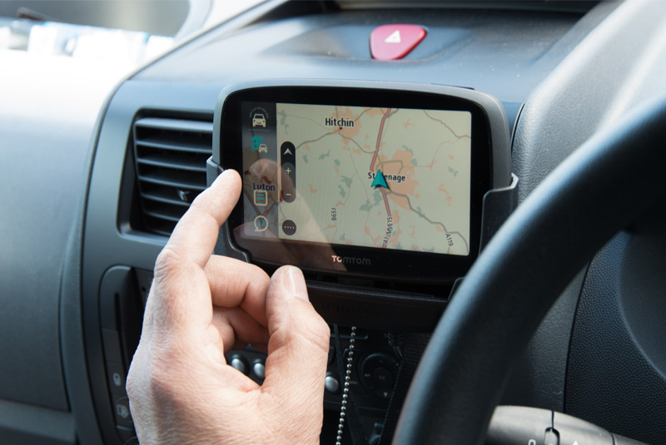
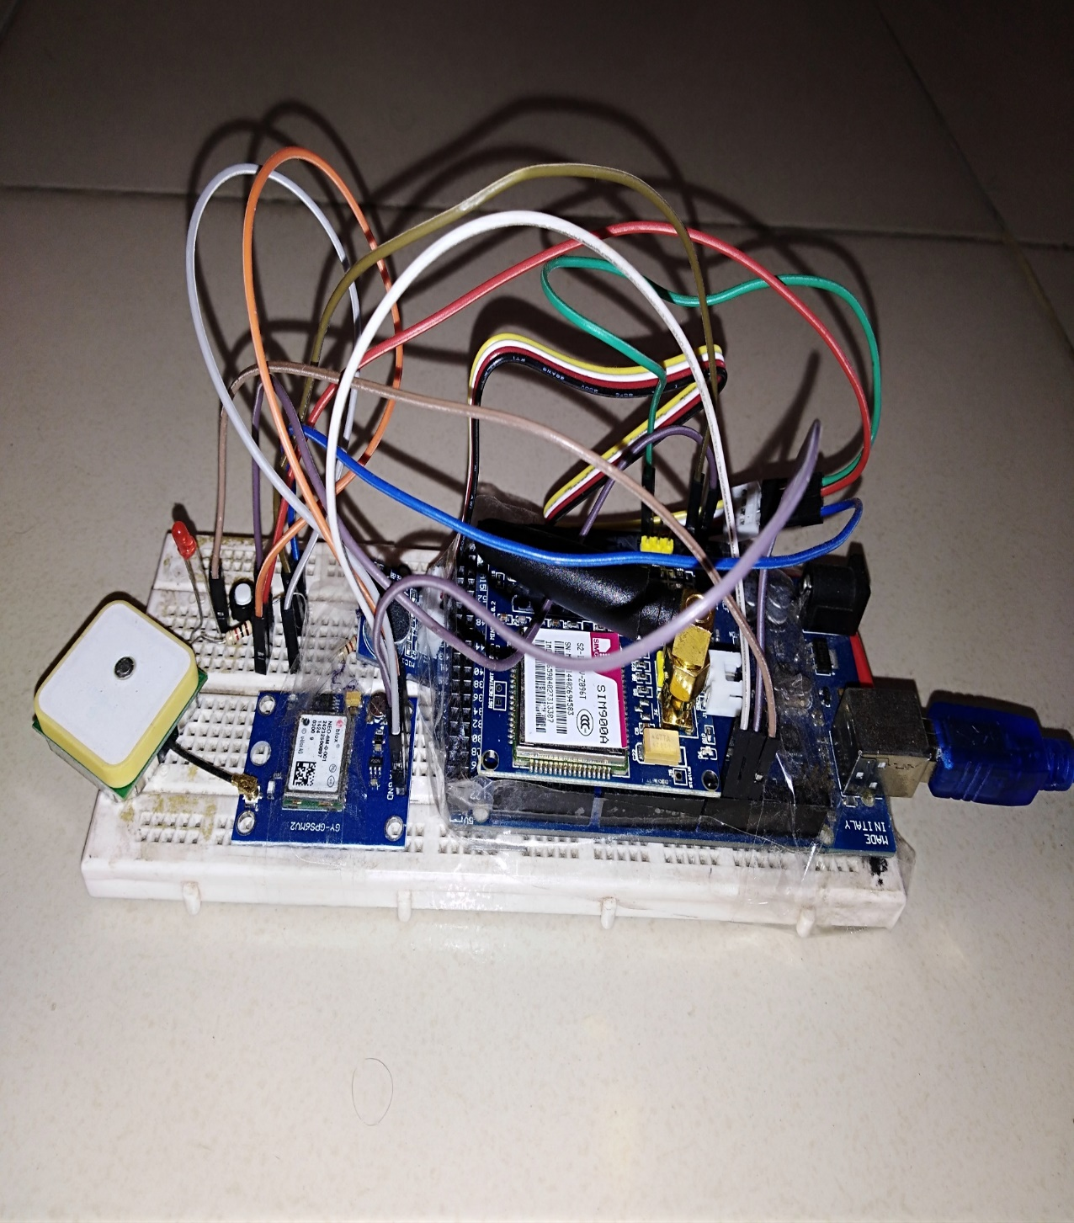
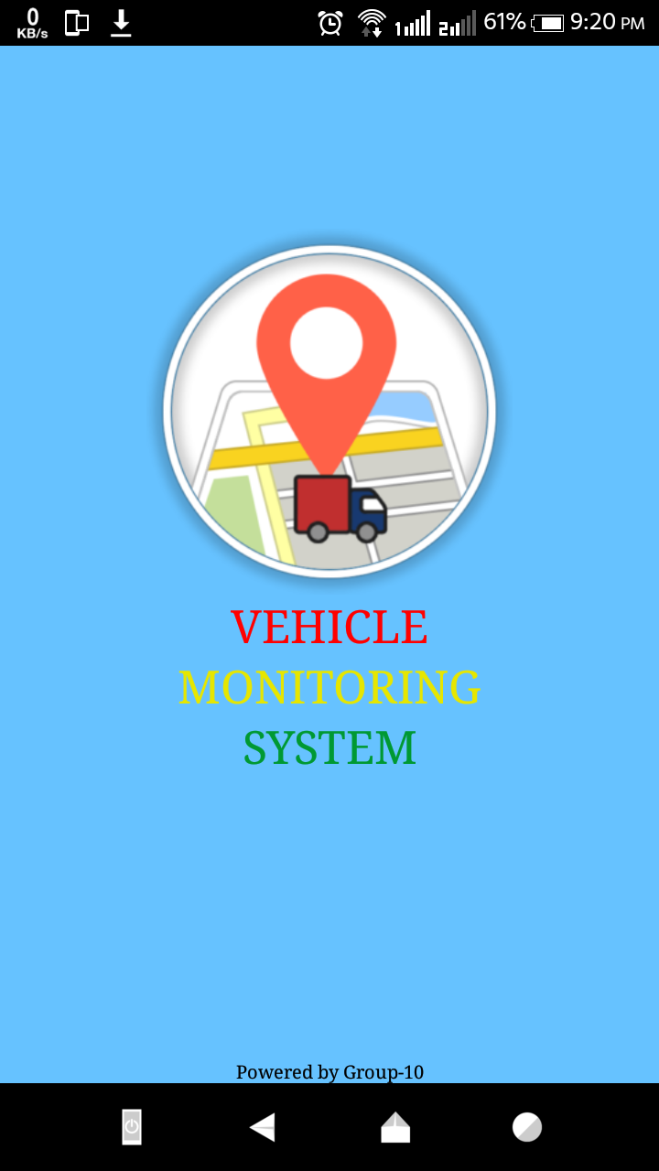
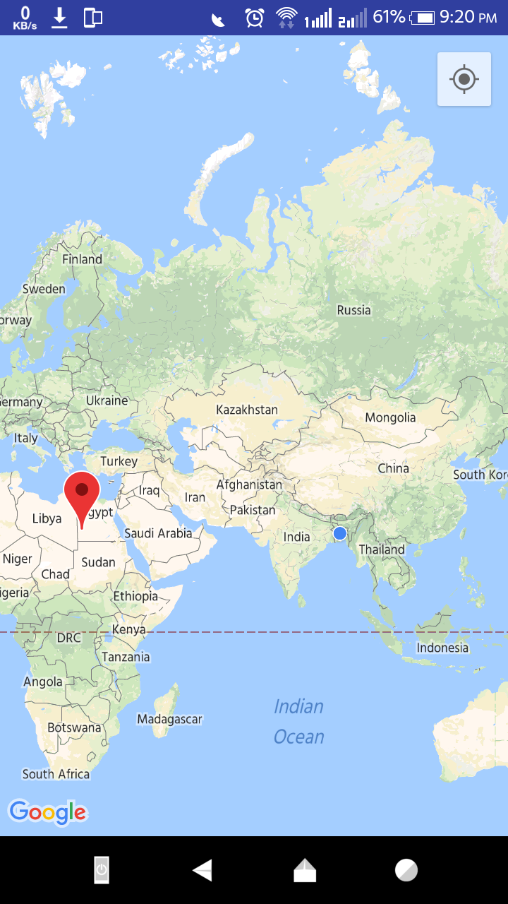
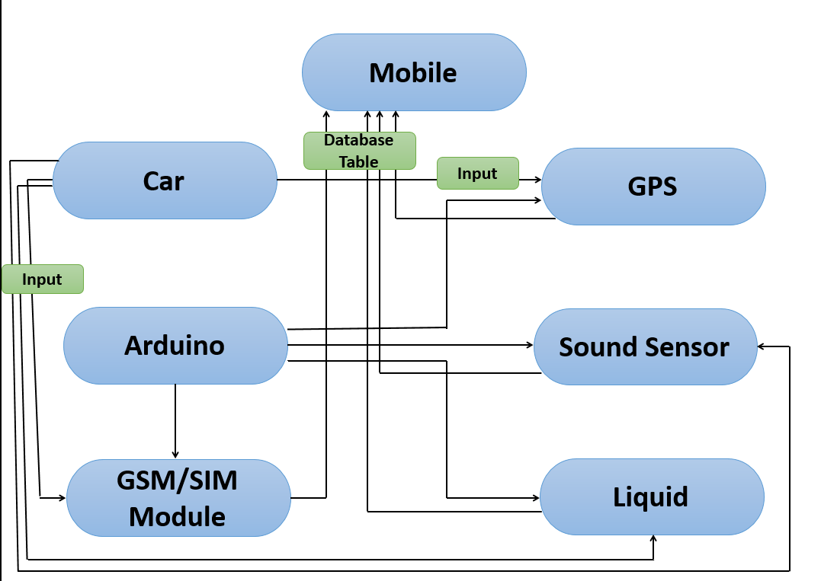
Vehicle Monitoring System
Developed By:Maj Mahboob ur Rahman,Md Shafiqul Alam Shawon,Mashruk Aulia,Ahsanul Alam, Akil Jawad,Mahmudul Hasan Bayezid.
Abstract
Working Flows
This is a project which can be implemented in the highways of our country to reduce the problems of road accidents and sound pollution. The methods we are going to using in this project are speed monitoring and fine, sound monitoring and fine and measuring the rate of fuel or petrol of the vehicle.
Introduction
The system that we are going to implement those vehicles can be easily identified which are crossing speed limit , which are willingly making sound pollution and can also detect the drivers of those vehicle who are stealing the fuel or petrol by measuring the rate of fuel or petrol.
we are also about to build up a mobile app which will coordinate with the database of our project and by means of which, the owner of private vehicles can monitor their drivers very easily as they are stealing the petrol of the vehicle or not and also authority can check if any vehicle crossing the speed limit or not.
Key Features
Figure2: Liquid Limit
Figure3:Speed and Sound Limit
Car’s speed detect through GSM module and data send to the APP. In case of exceeding speed limit, message will be sent to the authority.
Calculating the rate of petrol of a vehicle by using liquid level sensor.If the fuel or petrol consumption is more than the normal rate then a message will forward to the car owner.
Sensing the sound produced by a car in decibel and match that with the corresponding area’s sound limit, crossing sound limit will generate message to the authority.
Implemented System
Speed Limit
Petrol Limit
Figure4: Hardwire
implementation
Figure5: App’s Outlook
Figure6: Map Showing Location
Sound Limit
Conclusion
If we can implement our project efficiently, it will contribute in our national economy as well as public safety. We also believe that the implementation of this project will reduce the rate of road accidents and sound pollution.
System Architecture
References
Y. Yuan, “Towards blockchain-based intelligent transportation systems,” vol. 30, November 2016.
[Online]. Available: http://whatis.techtarget.com/deﬁnition/intelligenttransportation-system.Last access: 6.06pm, 13May,2018
Acknowledged By:
1)Brigadier General Khalil-Ur-Rahman
2) Maj Muhammad Nazrul Islam
3) Major Md Fazle Rabbi
4) Lecturer Tasmiah Tamzid Anannya
Figure1:System Architecture of the project

